Slide 1

Shopping Trend Analysis
Leverging data to analyze survey data identify significant trends, and improve customer satisfaction and product offering.

Slide 2

INTRODUCTION
This section provides a brief overview of the project focusing on the objective of enhacing shopping trends through data analysis using python,analyzing patterns,trends and insight in consumer shopping behaviour.

Slide 3
Understanding the Dataset:
Customer ID
Age
Gender
Item Purchased
Category: It has four category clothing ,footwear , accessories ,outwear
Purchase Amount (USD)
Location
Size
Color
Season
Review Rating: it is in between 1 to 5 range
Subscription Status
Payment Method
Shipping Type
Discount Applied
Promo Code Used
Previous Purchases
Preferred Payment Method
Frequency of Purchases: This is on the basis of Fortnightly ,weekly ,annually , Quarterly, Every 3 months

Slide 4
Data Cleaning and Preparation
Preparation :
Importing libraries : The necessary libraries such as pandas Matplotlib and seaborn will be imported.
Loading Dataset : The dataset will be loaded for further analysis.
Data exploration: Initial exploration of the dataset including the top 5 rows.
Data Cleaning :
Handling missing values : No missing values found
Handling Duplicates : No duplicate values found.

Slide 5
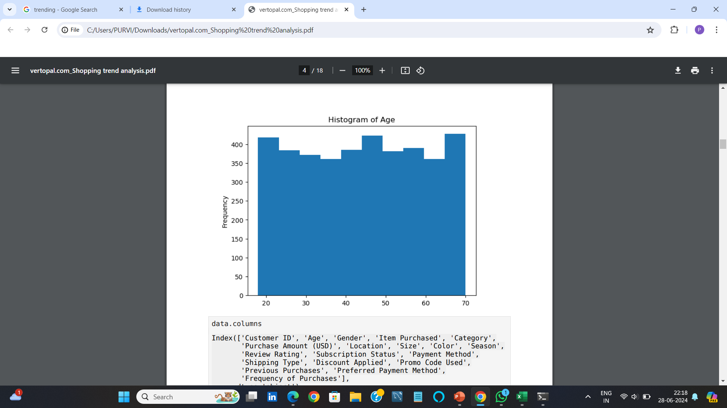
Descriptive Statistics
Summary statistics :
Mean Age :44.07
Mean Purchase Amount : $59.76
Mean Review Rating :3.75
VISUALS:
Histogram of Age

Slide 6
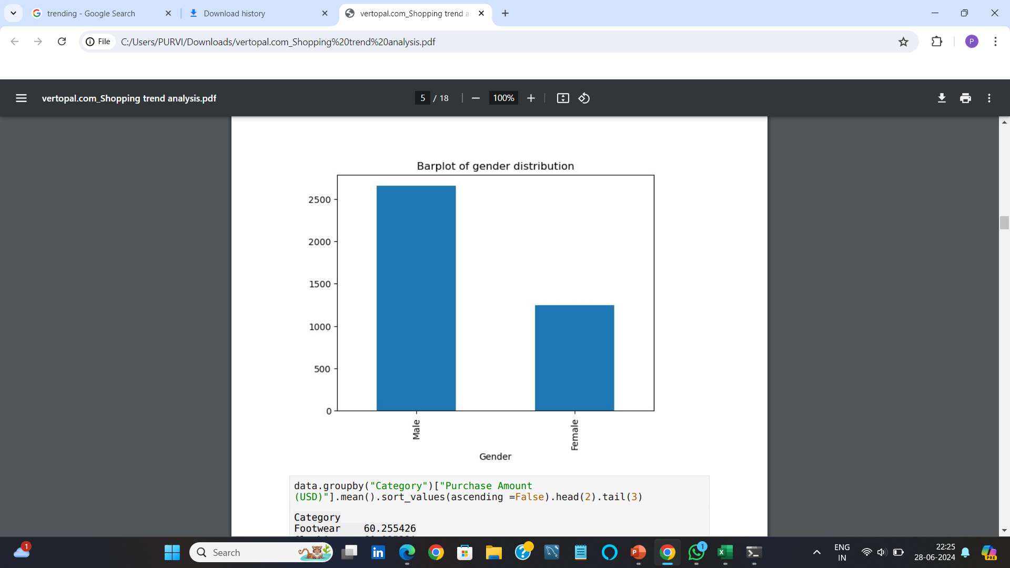
Gender Distribution
Insights :
The dataset has a balanced distribution of male and female shoppers.
This balance allows for fair comparison between genders in terms of shopping behavior.
Visuals:
Barplot of Gender distribution.

Slide 7
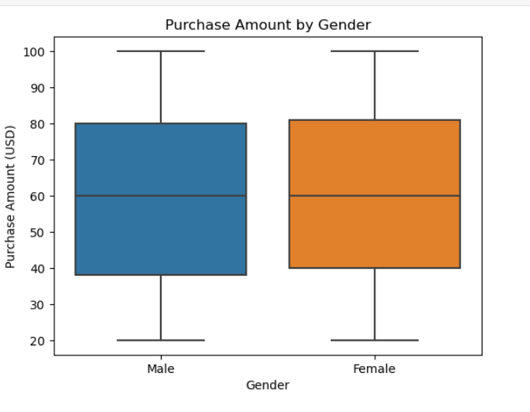
Purchase Amount by Gender
Insights:
The purchase amounts for both genders show some outliers, indicating a few very high-value purchases.
Generally, there is no significant difference in purchase amounts between male and female shoppers.
Visuals :
Boxplot of Purchase Amount by Gender.

Slide 8
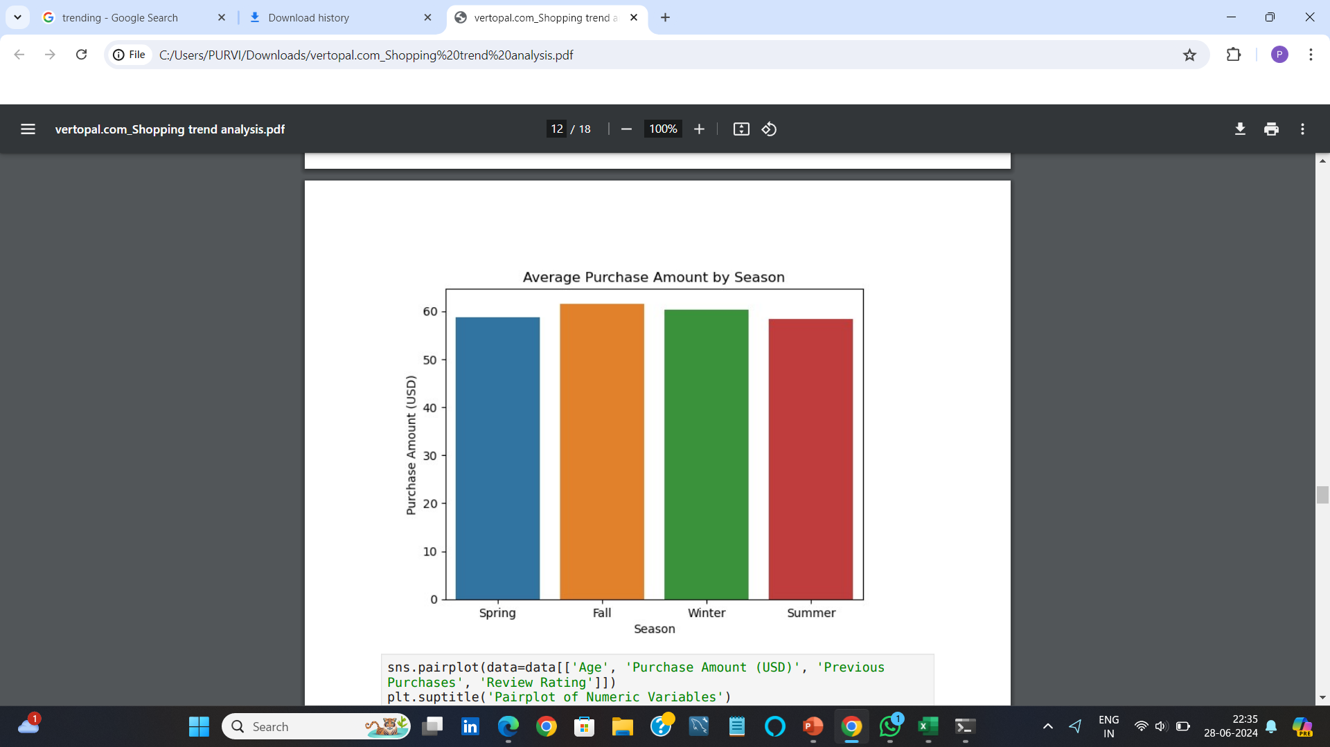
Purchase Amount by Season
Insights:
Average purchase amounts vary across different seasons.
The highest average purchase amount is observed in the Winter season.
The Spring season has the lowest average purchase amount.
Visuals:
Barplot of Average Purchase Amount by Season

Slide 9
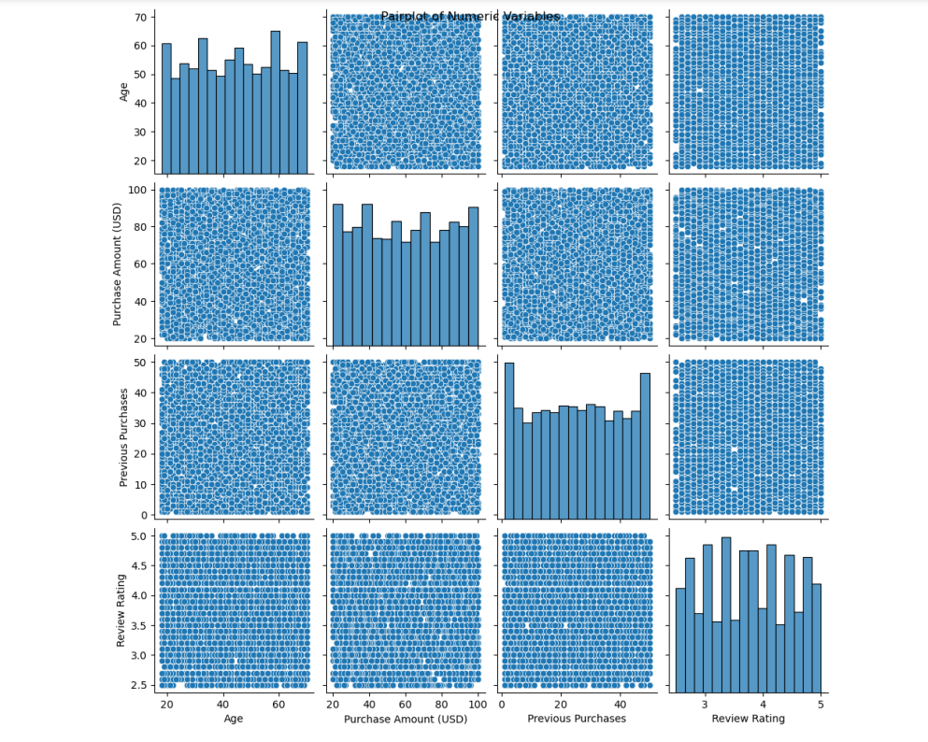
Pairplot of Numeric Variables
Insights:
There are some correlations between variables like Age, Purchase Amount, Previous Purchases, and Review Rating.
For example, older shoppers tend to have higher purchase amounts and more previous purchases.
Visuals:
Pairplot of Age, Purchase Amount, Previous Purchases, and Review Rating.

Slide 10
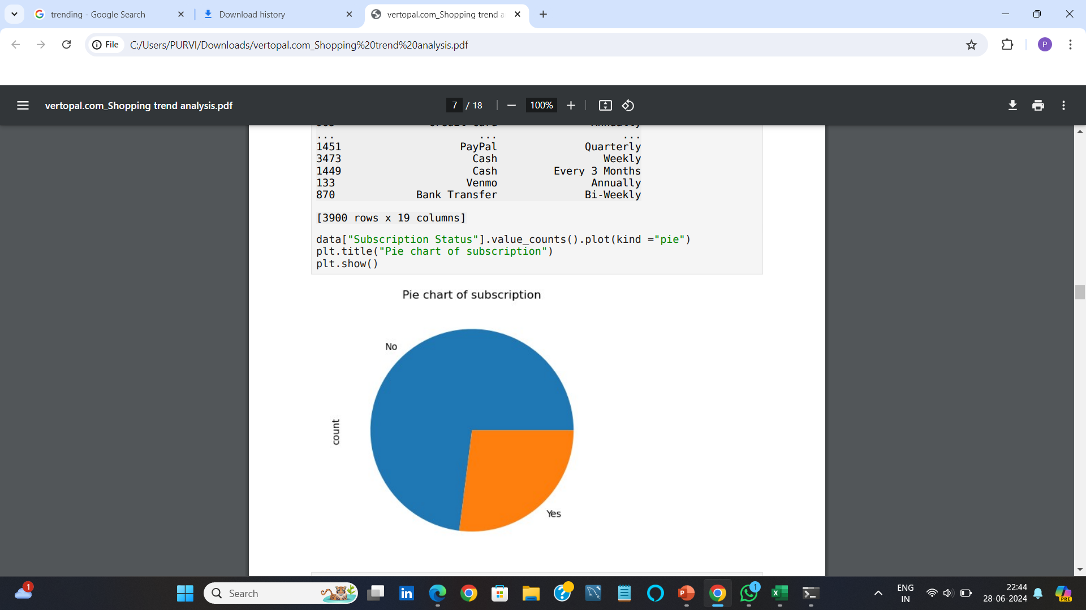
Subscription Status Distribution
Insights:
A significant portion of shoppers are not subscribed.
The subscription status of shoppers may influence their shopping behavior and purchase frequency.
Visuals:
Pie Chart of Subscription Status.

Slide 11
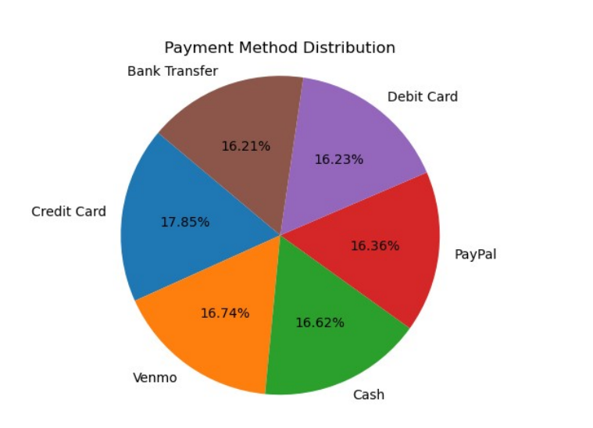
Payment Method Distribution
Insights :
Certain payment methods are more popular among shoppers.
The most preferred payment method is Credit Card.
Visuals :
Pie Chart of Payment Method Distribution.

Slide 12
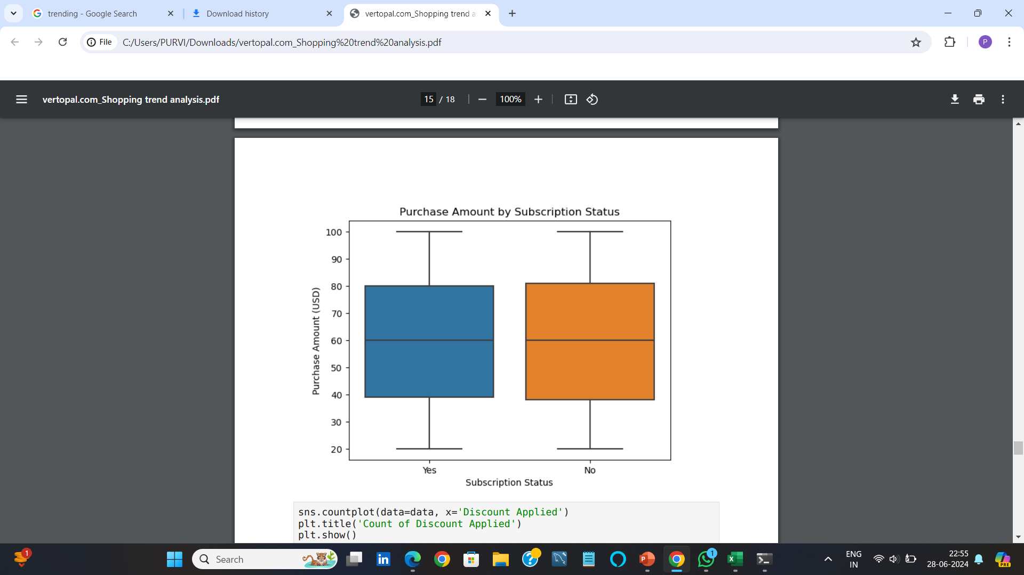
Purchase Amount by Subscription Status
Insights:
Subscribers tend to spend more on average compared to non-subscribers.
This indicates that subscription status may have a positive impact on purchase amounts.
Visuals:
Boxplot of Purchase Amount by Subscription Status.

Slide 13
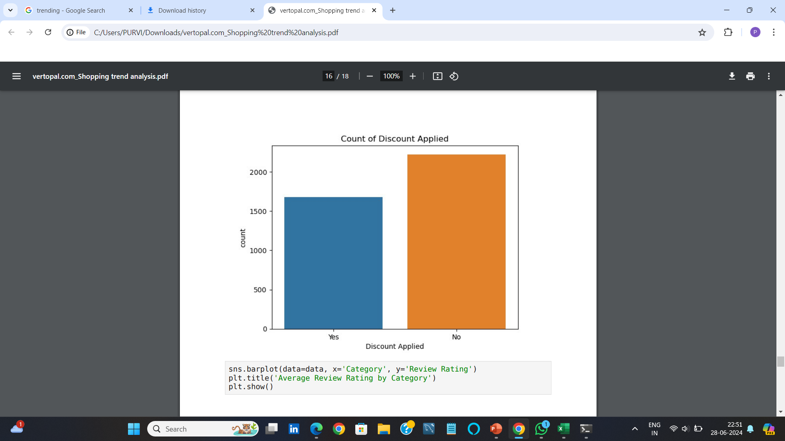
Discount Applied
Insights :
Discounts are frequently applied to purchases, suggesting promotions and discounts are common strategies to boost sales.
Understanding the impact of discounts on purchase behavior can help in designing better marketing strategies.
Visuals:
Countplot of Discount Applied.

Slide 14
Key Insights
Summary :
Age distribution shows a diverse range of shoppers
Higher purchase amounts in specific seasons and categories
Subscription status influences purchase amounts
Recommendations:
Target marketing campaigns based on age and subscription status
Optimize inventory based on seasonal trends

